Slide 1



University Institute of Engineering
DEPARTMENT OF COMPUTER SCIENCE & ENGINEERING
Subject Name: Software Engineering
Subject Code: 23CST-206
Er. Jagmeet Kaur
E8387
ASSISTANT PROFESSOR
CSE
DISCOVER . LEARN . EMPOWER

Slide 2
Topics covered
Unified Modeling Language

Slide 3
Unified Modeling Language
Unified Modeling Language (UML) is a general purpose modeling language.
The main aim of UML is to define a standard way to visualize the way a system has been designed.
It is quite similar to blueprints used in other fields of engineering.

Slide 4
Unified Modeling Language
UML is not a programming language, it is rather a visual language.
We use UML diagrams to portray the behavior and structure of a system.
UML helps software engineers, businessmen and system architects with modeling, design and analysis

Slide 5
Need of UML
Complex applications need collaboration and planning from multiple teams and hence require a clear and concise way to communicate amongst them.
Businessmen do not understand code. So UML becomes essential to communicate with non programmers essential requirements, functionalities and processes of the system.
A lot of time is saved down the line when teams are able to visualize processes, user interactions and static structure of the system.

Slide 6
Classification of UML
Diagrams in UML can be broadly classified as:
Structural Diagrams – Capture static aspects or structure of a system. Structural Diagrams include: Component Diagrams, Object Diagrams, Class Diagrams and Deployment Diagrams.
Behavior Diagrams – Capture dynamic aspects or behavior of the system. Behavior diagrams include: Use Case Diagrams, State Diagrams, Activity Diagrams and Interaction Diagrams.

Slide 7
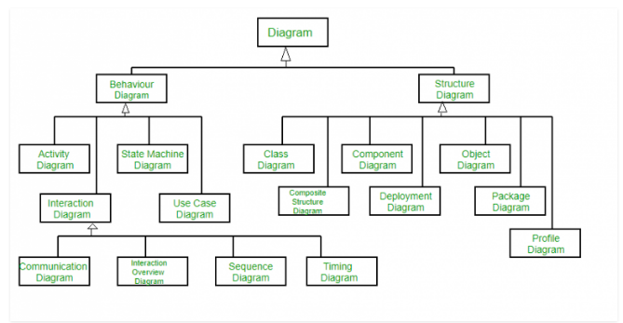
Classification of UML

Slide 8
Structural UML Diagrams
Class Diagram –
The most widely use UML diagram is the class diagram. It is the building block of all object oriented software systems.
We use class diagrams to depict the static structure of a system by showing system’s classes, their methods and attributes.
Class diagrams also help us identify relationship between different classes or objects.

Slide 9
Class Diagram
The purpose of class diagram is to model the static view of an application.
Class diagrams are the only diagrams which can be directly mapped with object-oriented languages and thus widely used at the time of construction.
The purpose of the class diagram −
Analysis and design of the static view of an application.
Describe responsibilities of a system.
Base for component and deployment diagrams.
Forward and reverse engineering.

Slide 10
Class Diagram
The following points should be remembered while drawing a class diagram −
The name of the class diagram should be meaningful to describe the aspect of the system.
Each element and their relationships should be identified in advance.
Responsibility (attributes and methods) of each class should be clearly identified
For each class, minimum number of properties should be specified, as unnecessary properties will make the diagram complicated.
Use notes whenever required to describe some aspect of the diagram. At the end of the drawing it should be understandable to the developer/coder.
Finally, before making the final version, the diagram should be drawn on plain paper and reworked as many times as possible to make it correct.

Slide 11
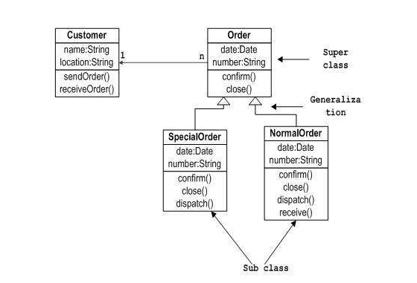
Class Diagram : Example

Slide 12
Where to Use Class Diagrams?
Describing the static view of the system.
Showing the collaboration among the elements of the static view.
Describing the functionalities performed by the system.
Construction of software applications using object oriented languages.

Slide 13
Structural UML Diagrams
Composite Structure Diagram –
We use composite structure diagrams to represent the internal structure of a class and its interaction points with other parts of the system.
A composite structure diagram represents relationship between parts and their configuration which determine how the classifier (class, a component, or a deployment node) behaves.
They represent internal structure of a structured classifier making the use of parts, ports, and connectors.
We can also model collaborations using composite structure diagrams.
They are similar to class diagrams except they represent individual parts in detail as compared to the entire class.

Slide 14
Structural UML Diagrams
Object Diagram
An Object Diagram can be referred to as a screenshot of the instances in a system and the relationship that exists between them.
Since object diagrams depict behavior when objects have been instantiated, we are able to study the behavior of the system at a particular instant.

Slide 15
Structural UML Diagrams
Object diagrams are derived from class diagrams so object diagrams are dependent upon class diagrams.
Object diagrams represent an instance of a class diagram. The basic concepts are similar for class diagrams and object diagrams.
Object diagrams also represent the static view of a system but this static view is a snapshot of the system at a particular moment.
Object diagrams are used to render a set of objects and their relationships as an instance.

Slide 16
Structural UML Diagrams
The purpose of the object diagram can be summarized as −
Forward and reverse engineering.
Object relationships of a system
Static view of an interaction.
Understand object behaviour and their relationship from practical perspective

Slide 17
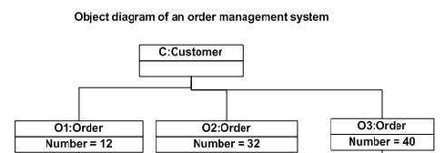
Structural UML Diagrams

Slide 18
Structural UML Diagrams
The following points are to be decided before starting the construction of the diagram −
The object diagram should have a meaningful name to indicate its purpose.
The most important elements are to be identified.
The association among objects should be clarified.
Values of different elements need to be captured to include in the object diagram.
Add proper notes at points where more clarity is required.

Slide 19
Structural UML Diagrams
Component Diagram
Component diagrams are used to represent the how the physical components in a system have been organized.
We use them for modeling implementation details.
Component Diagrams depict the structural relationship between software system elements and help us in understanding if functional requirements have been covered by planned development.

Slide 20
Structural UML Diagrams
Component Diagram
Component diagram is a special kind of diagram in UML.
It does not describe the functionality of the system but it describes the components used to make those functionalities.
Thus from that point of view, component diagrams are used to visualize the physical components in a system. These components are libraries, packages, files, etc.

Slide 21
Structural UML Diagrams
The purpose of the component diagram can be summarized as −
Visualize the components of a system.
Construct executables by using forward and reverse engineering.
Describe the organization and relationships of the components.
Component diagrams can be used to −
Model the components of a system.
Model the database schema.
Model the executables of an application.
Model the system's source code.

Slide 22
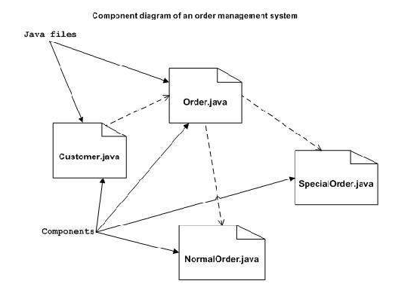
Component Diagram

Slide 23
Structural UML Diagrams
Deployment Diagram –
Deployment Diagrams are used to represent system hardware and its software.
It tells us what hardware components exist and what software components run on them.
We illustrate system architecture as distribution of software artifacts over distributed targets.
An artifact is the information that is generated by system software.
They are primarily used when a software is being used, distributed or deployed over multiple machines with different configurations.

Slide 24
Structural UML Diagrams
Deployment diagrams are used for describing the hardware components, where software components are deployed.
Component diagrams and deployment diagrams are closely related.
Component diagrams are used to describe the components and deployment diagrams shows how they are deployed in hardware.
The purpose of deployment diagrams can be described as −
Visualize the hardware topology of a system.
Describe the hardware components used to deploy software components.
Describe the runtime processing nodes.

Slide 25
Deployment Diagram
Deployment diagrams can be used −
To model the hardware topology of a system.
To model the embedded system.
To model the hardware details for a client/server system.
To model the hardware details of a distributed application.
For Forward and Reverse engineering.

Slide 26
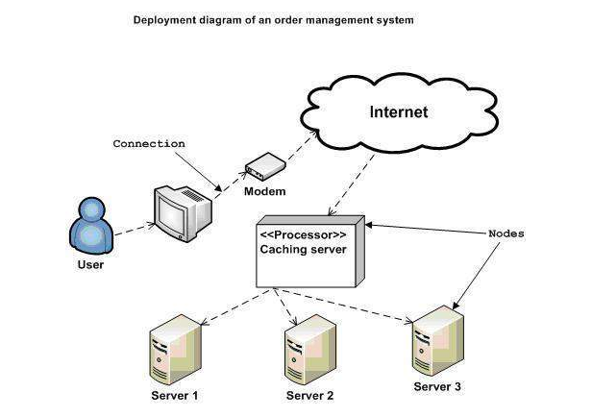
Deployment Diagram

Slide 27
Structural UML Diagrams
Package Diagram
We use Package Diagrams to depict how packages and their elements have been organized.
A package diagram simply shows us the dependencies between different packages and internal composition of packages.
Packages help us to organize UML diagrams into meaningful groups and make the diagram easy to understand.
They are primarily used to organize class and use case diagrams.

Slide 28
Structural UML Diagrams
Package Diagram
A package is a grouping of model elements which means that a package can contain model elements of different kinds, including other packages to create hierarchies.
Package diagram is used to simplify complex class diagrams, you can group classes into packages.
A package is a collection of logically related UML elements.

Slide 29
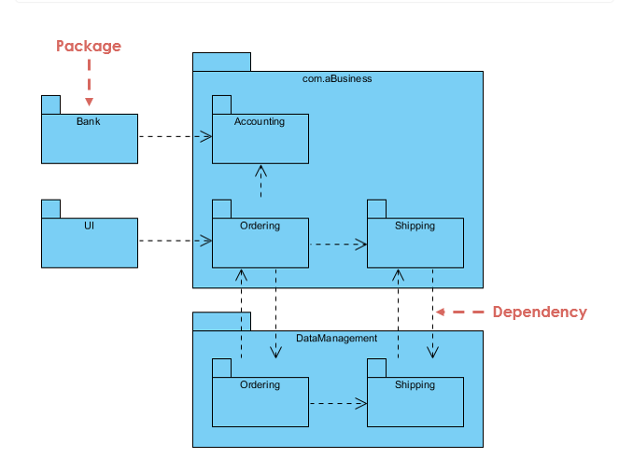
Package Diagram

Slide 30
REFERENCES
Reference Books:
Suman Ugrasen, “Software Engineering - Concepts and Practices”, First Edition, Cengage.
Mohammad Ali Shaikh, “Software Engineering with UML”, Third Edition, Notion Press.
Somerville Ian, “Software Engineering”, Addison Wesley, 8th Edition.
Text Books:
Pressman Rogers, “Software Engineering: A Practitioner's Approach”, Sixth edition. Patterson and Hennessy, “Computer Architecture” , Fifth Edition Morgaon Kauffman.
Rajib Mall, “Fundamentals of Software Engineering’’, Fourth Edition, Pearson, PHI.
Image References:
https://www.geeksforgeeks.org/unified-modeling-language-uml-introduction/
https://www.uml.org/

Slide 31
THANK YOU

